Slide 1

Phish Phingers
Project by Saph, Callum and Luca

Slide 2
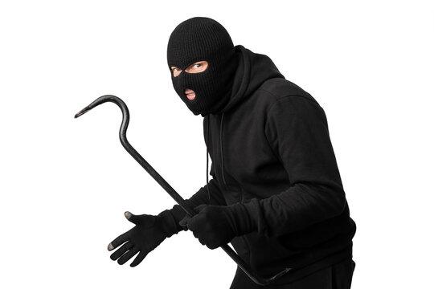
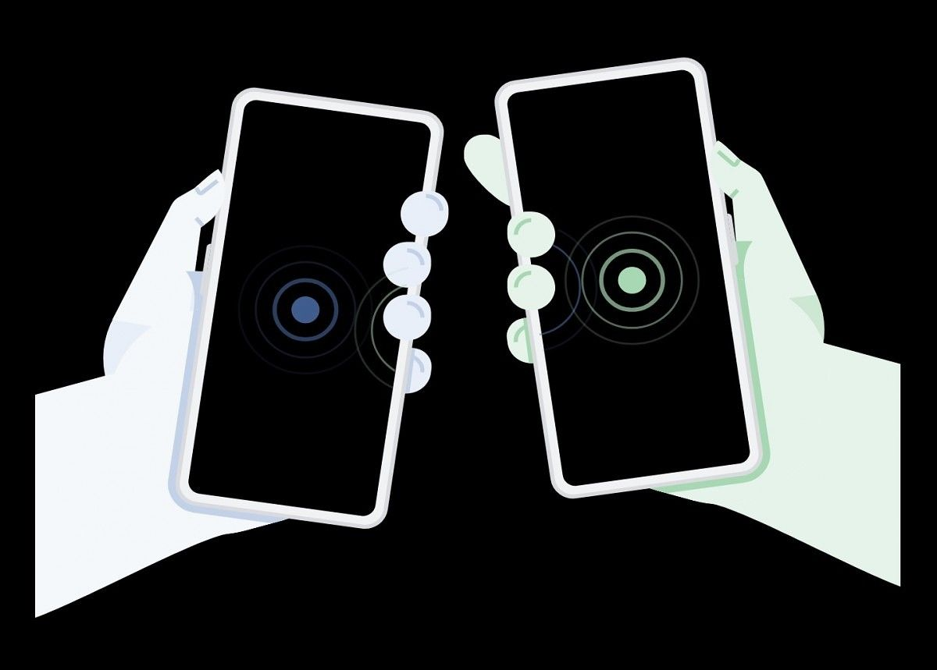
Making Credit Card Theft Fun (and not illegal)
Phish Phingers is a long-term social challenge game for a group of friends to try and steal each others credit card information. Players link their devices, one player is the 'Host' and target of all the 'Hunters'. For the duration of play (set by the players) the Hunters must sneak access to the Host's phone and 'Catch' them while the Host must stay safe.

Slide 3
Initial Ideation

Slide 4
Concept Sketches
Circuit Diagram
Gameplay Diagram
Housing + Implementation

Slide 5
Inspirations
Lazer Tag
Wormhole (pin game)
Flipper Zero
Skylanders~
Credit Card Theft

Slide 6
Reasonings
Technically Interesting
Entertaining
Informative of Security
Learning CySec concepts and product design

Slide 7
Collaborations and Learning Developments
Electronics and Programming for RFID
CySec Soc/Department, informing on RFID crime
Game Design (Sport)
Product Design
Law/Ethics – Protecting from Misuse
Textiles/Fashion?

Slide 8
Logo/Branding

Slide 9
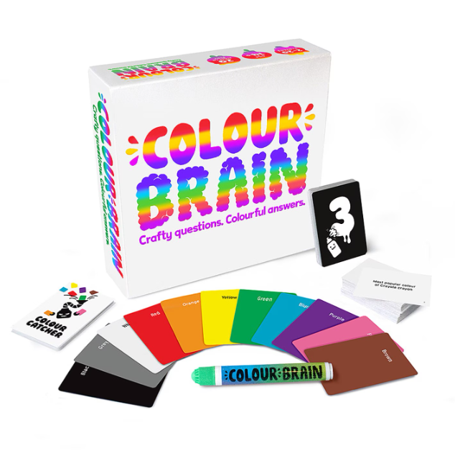

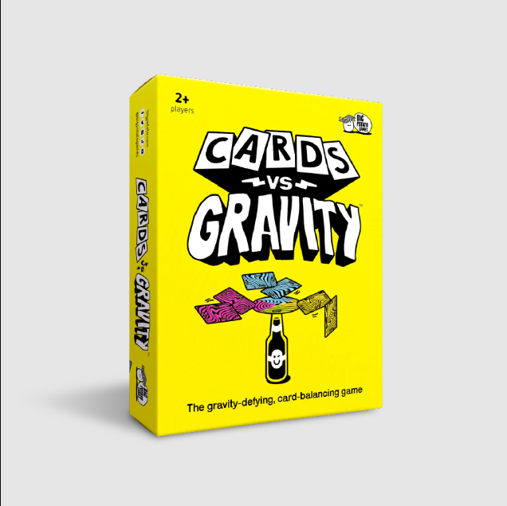
Inspirations

Slide 10
Inspirations
For the graphic design of our project, we drew inspiration from the bold, playful aesthetics of popular party games like Get the Ick, Cards vs Gravity, and Colour Brain which use bright colours, quirky typography, and eye-catching layouts to create a sense of excitement which is something we aimed to replicate in our own branding. Since our game explores themes like cyber security and credit card theft, it was important for us to strike a balance between informative content and an inviting, non-intimidating atmosphere. By channelling the visual language of these vibrant party games, we were able to craft a logo and visual identity that supports our goal of gamifying serious topics in a way that is fun, engaging, and approachable for a wide audience.

Slide 11

Colour Scheme
As such, we decided to employ a similar vibrant colour scheme to that used by the aforementioned branding inspirations. By utilising bright cyans, yellows, magenta with a contrast of black and white typography, our logo aims to successfully achieve the evocation of the sense of fun that we aim to elucidate in audiences. Our primary aim is to raise cyber security awareness and not make it seem intimidating.

Slide 12
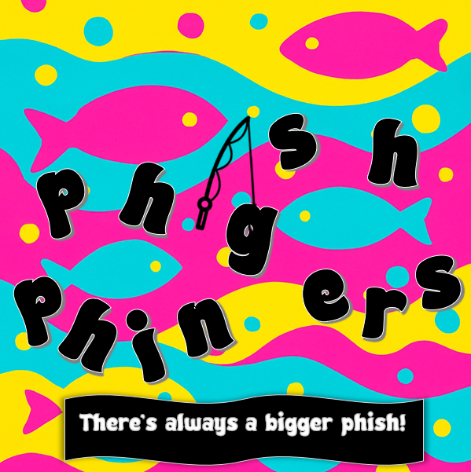
Our logo
In the end, this was the design we ended up creating. We came up with a fun name that bridges the ludic nature of our game and our aim to raise cyber security awareness via a pun – making use of the term “phish” associated with scams. As such, our branding includes fish and water imagery which, in turn, almost makes the word “phish” seem less threatening by underscoring its association with the vibrantly coloured, somewhat cute looking fish in our branding.

Slide 13
Design/Layout

Slide 14
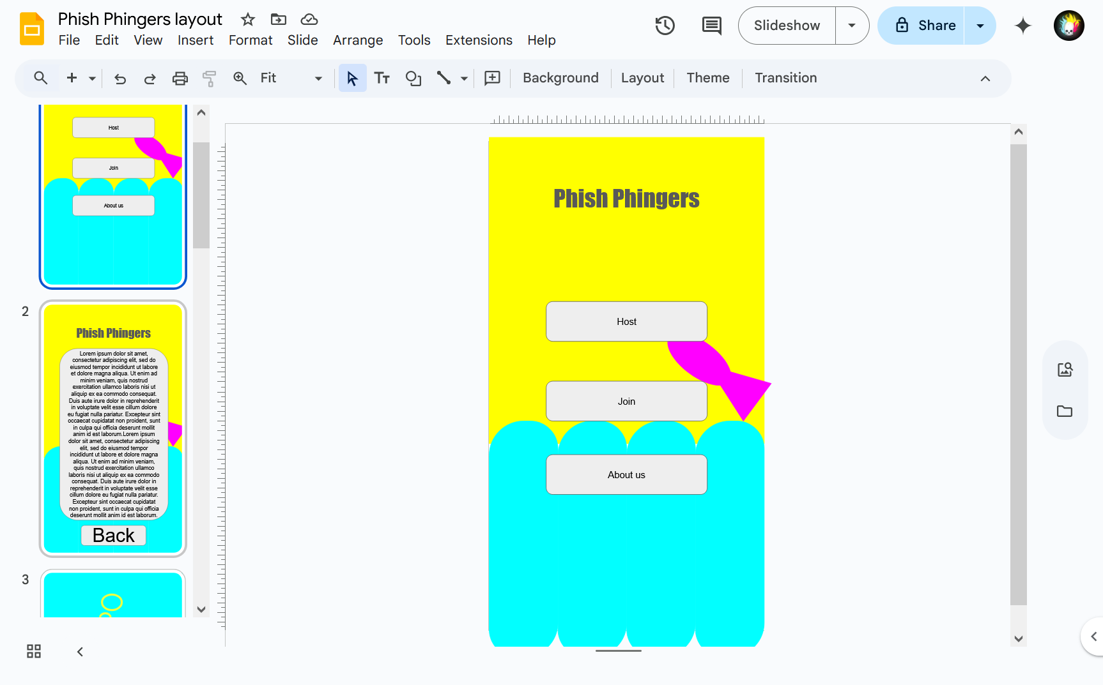
Prototyping Layout
To establish a solid foundation for our app’s design, we began with a simple PowerPoint prototype. This allowed us to quickly click through screens and test the overall user flow of the app.
We identified the key pages needed for our initial prototype:
Main Menu
Hosting
Game Mode selection
Joining
About Us
In-Play

Slide 15
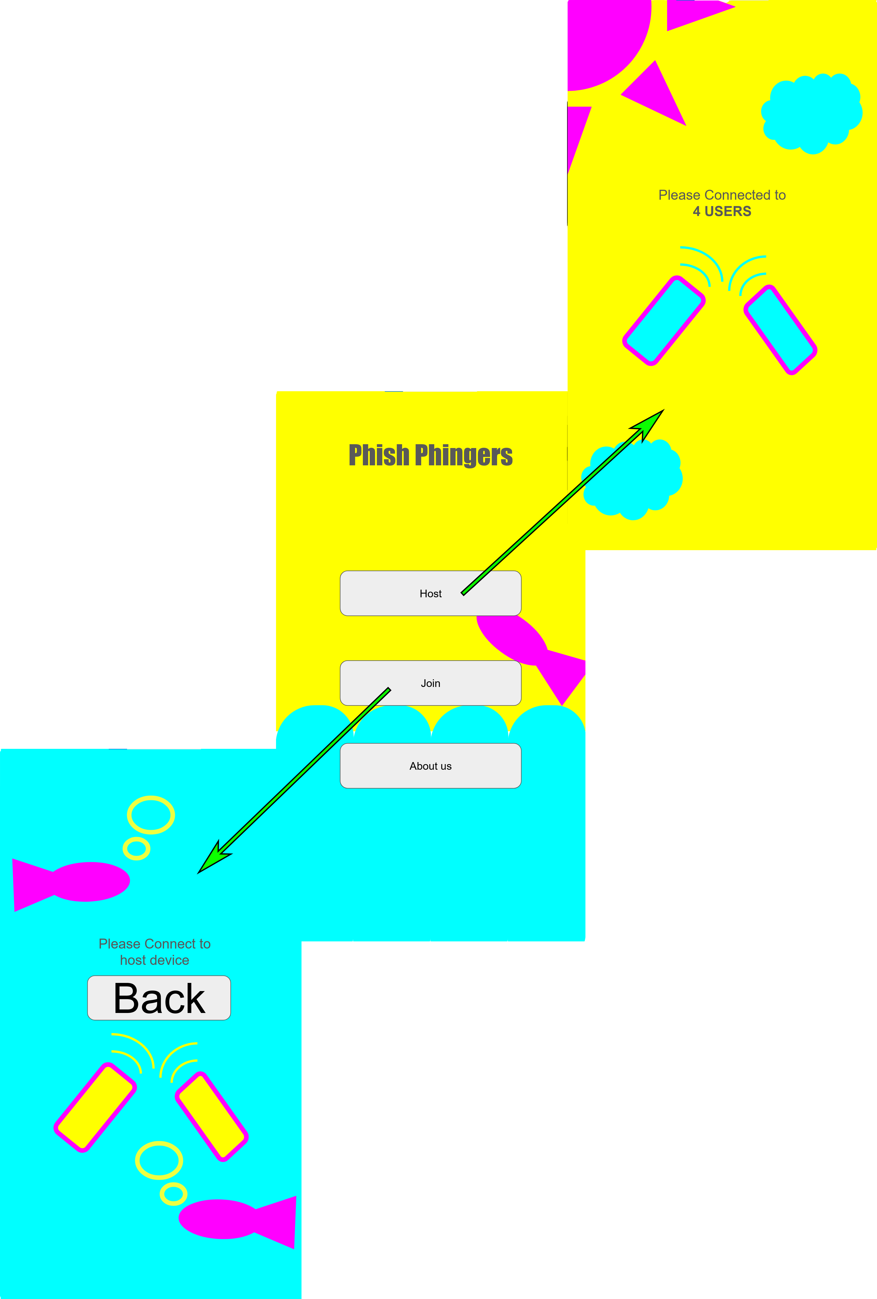
Prototyping Design
Our game features two opposing teams: the Hunters and the Hunted. To reflect this dynamic, we incorporated subtle visual cues into the design:
Joining a game takes the player beneath the sea, visually transforming them into the hunted — a fish.
Hosting a game lifts the player into the clouds, symbolizing a hunter’s perspective looking down from above.
These transitions add a subtle layer of immersion, helping players feel more connected to their role in the game.
We also found that static screens can give the impression that the app has frozen. To keep the experience feeling alive and responsive:
Bubbles were added to underwater scenes
Moving clouds animate the sky
These ambient animations help maintain user engagement and prevent confusion or frustration. The prototype

Slide 16
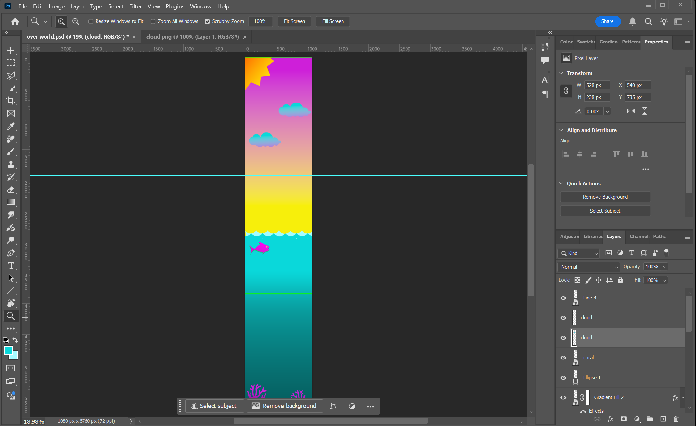
Assets
Once we finalized the design concept, I moved into Photoshop to create all the visual assets needed for the app’s background.
To accommodate scrolling in the app, I started by using a standard phone resolution and tripled the height, allowing users to scroll up and down for a more dynamic experience.
The essential assets I designed included:
Background
Waves
Fish
Coral
Clouds
Sun
Bubbles

Slide 17
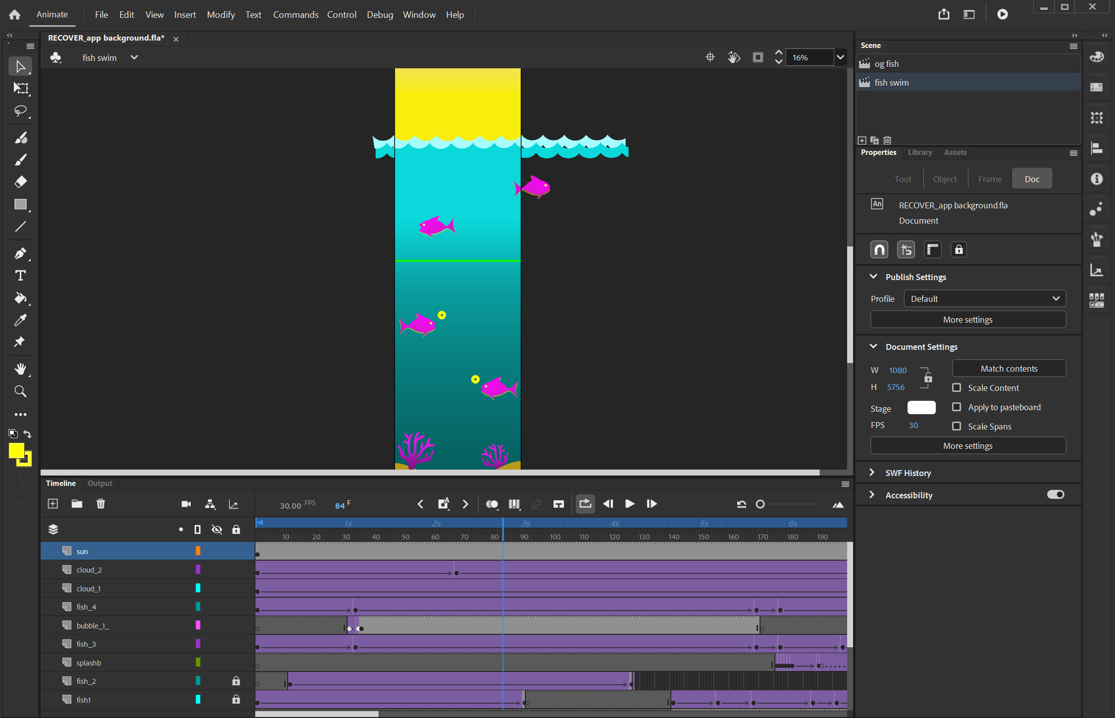
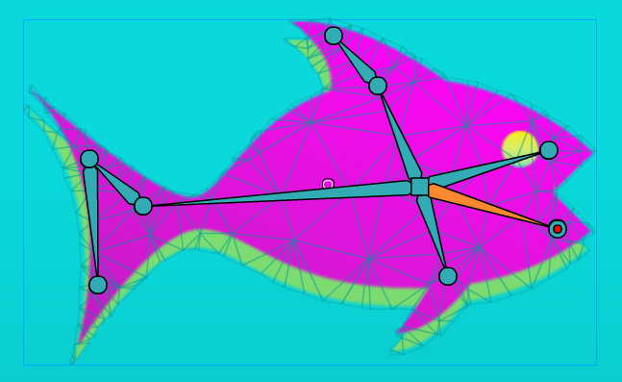
Animation
After designing the assets, I moved into Adobe Animate to bring them to life. This involved:
Converting each asset into symbols, allowing for efficient animation and reuse.
Adding bones and rigs to certain elements like fins and mouths to create natural, fluid movements.
These animations added character to the app and helped reinforce a sense of liveliness and immersion throughout the user experience.

Slide 18

Final Animation
Once all the elements were combined — the design, assets, and animations — we created the final animated scene for the app.
This brings the user interface to life, blending functionality with visual storytelling to create a more immersive experience.

Slide 19
Technical

Slide 20
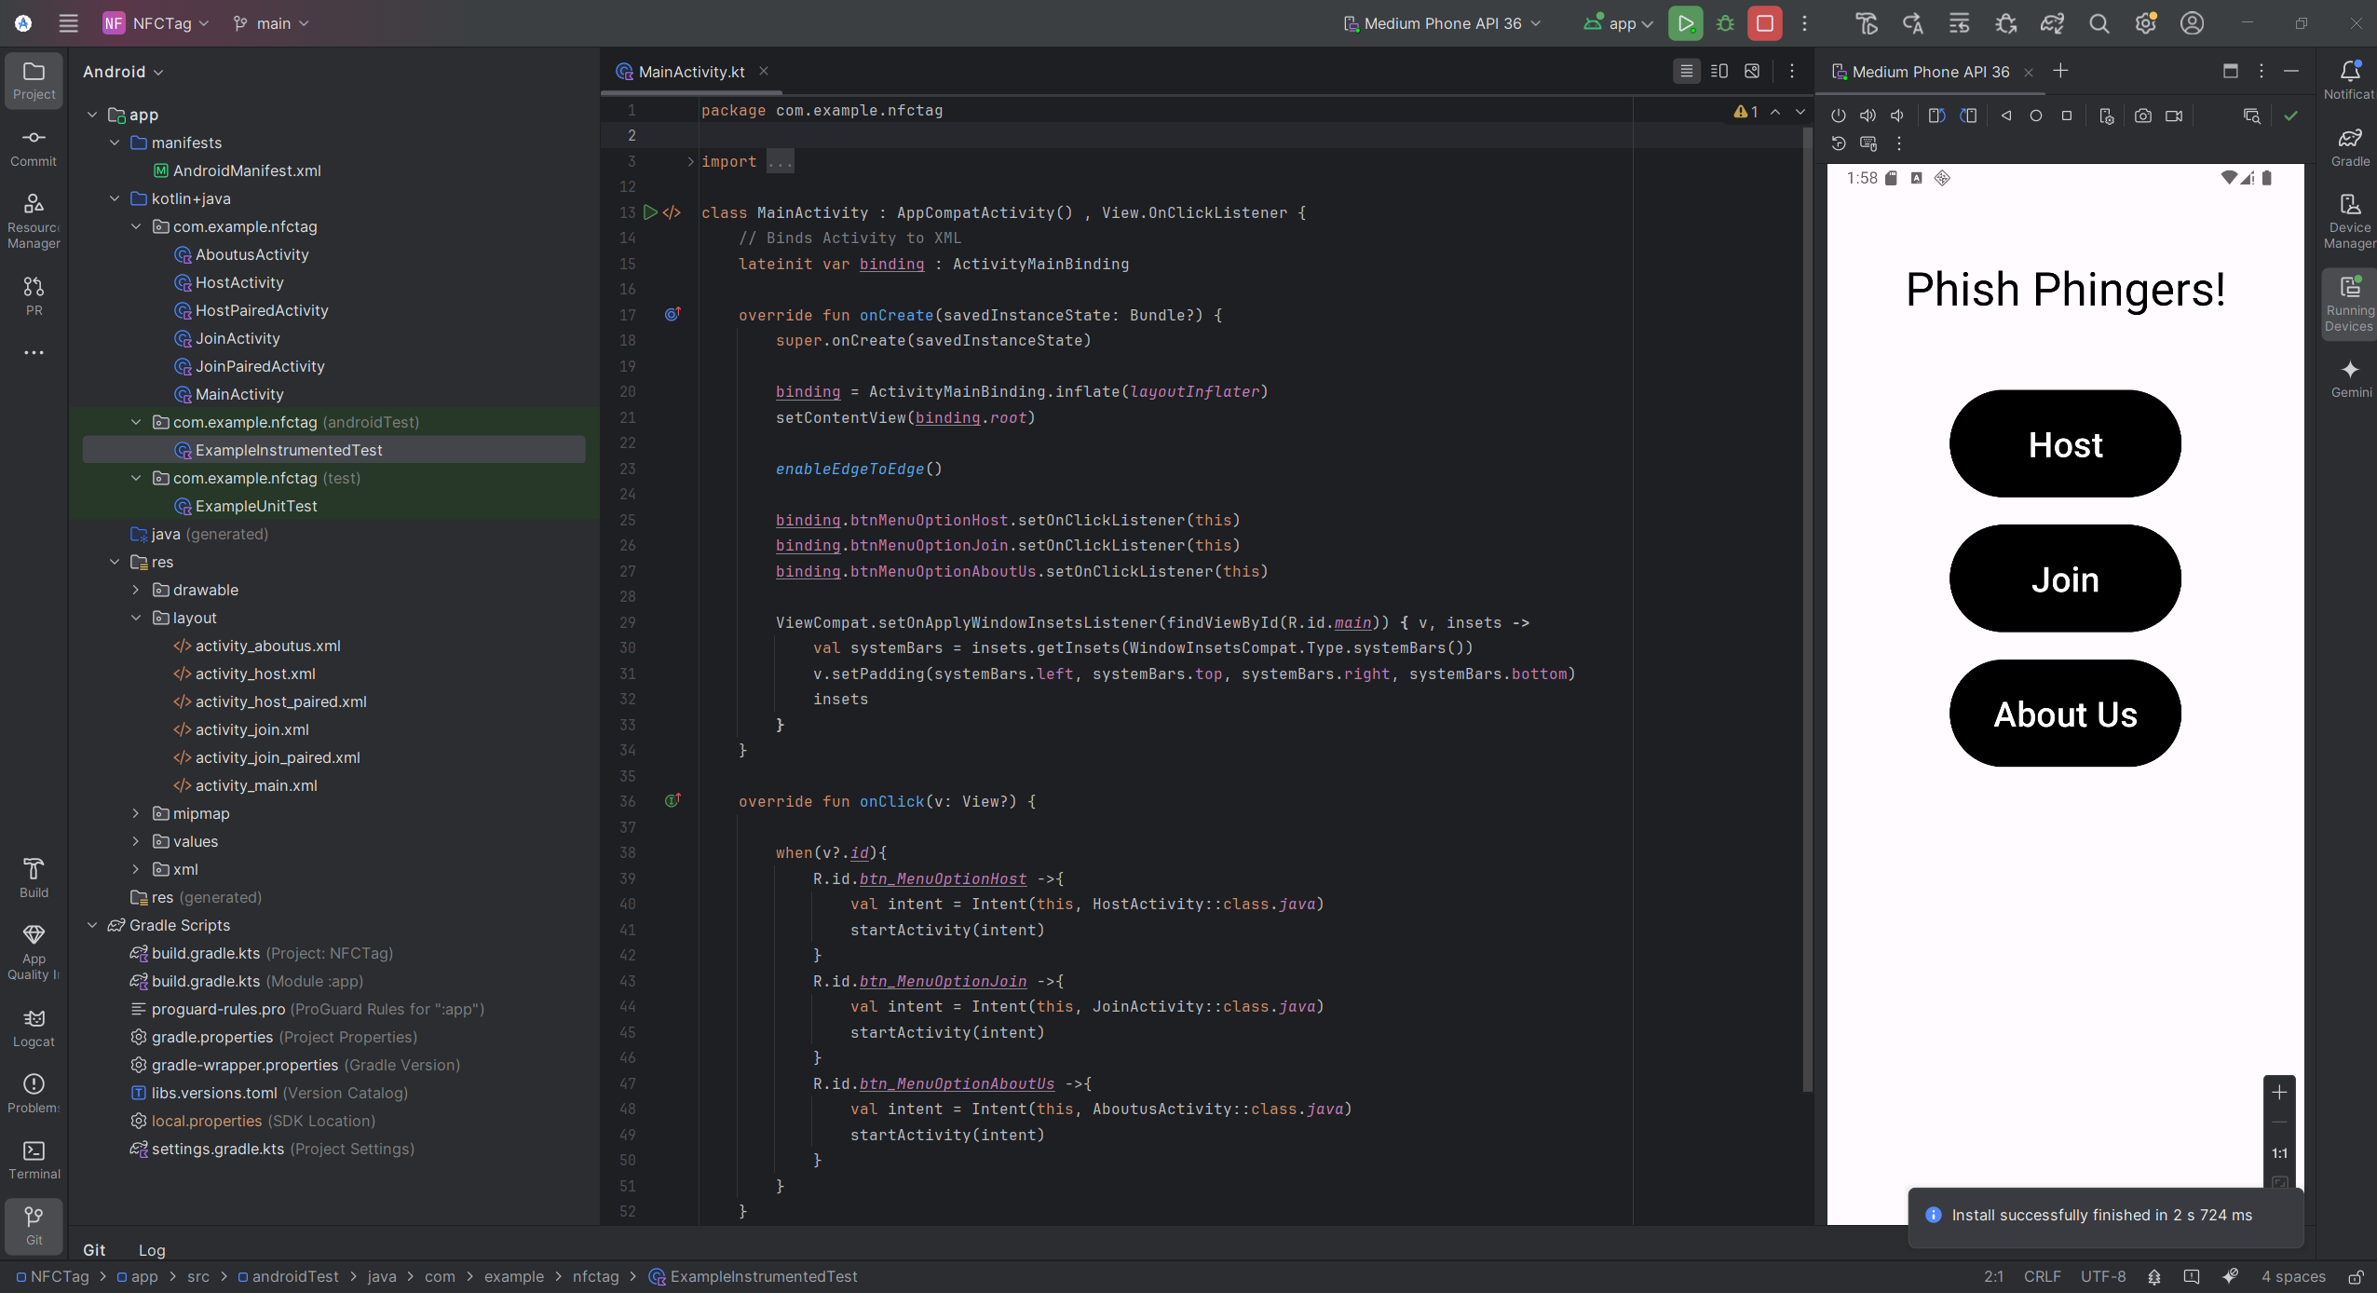
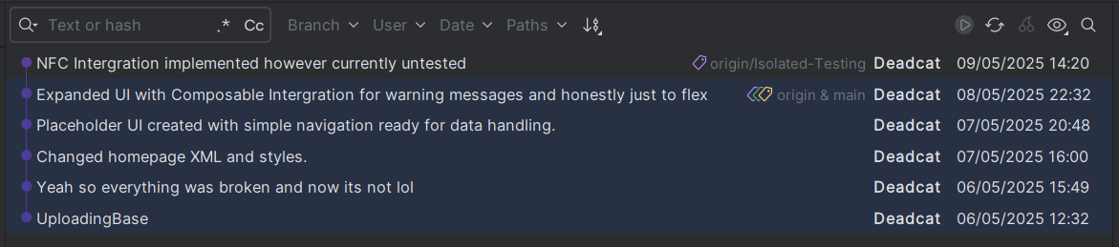
Application + UI
The App is written in Kotlin (agony I hate this language) using Android Studio. Version control handled through Git. The base UI uses a Views format with a ViewModel Binding. Retrospectively this could have been a MVVM based application however I was still learning the language and chose to prioritise the extra technical requirements over upgrading the entire project.

Slide 21
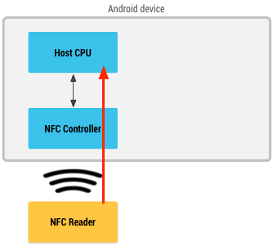
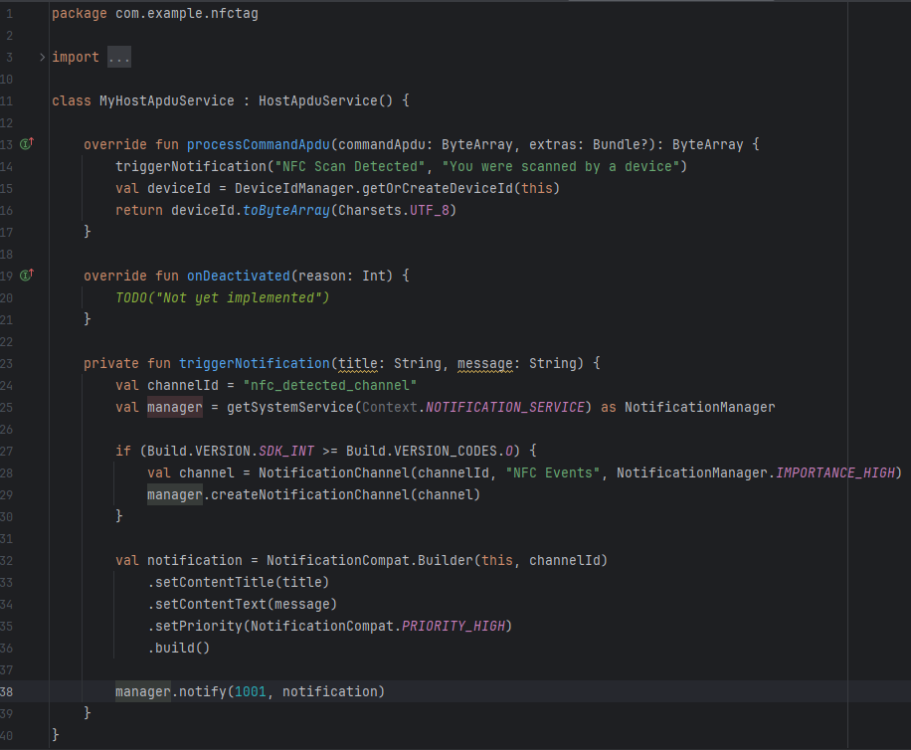
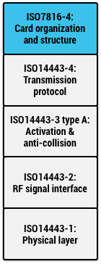
NFC Card Emulation
NFC Can be handled in multiple ways however for our needs where the target device will not have the application open we require Host-based Card Emulation (HCE) where the hosting device is treated as an NFC tag rather than an Read/Write mode which is used to interact with static tags*. HCE systems only use the ISO NFC Protocol
HCE systems require an Application-ID (AID) which routes the NFC signal to the desired application, this is how Contactless payment machines can open wallet apps.
The MyHostApduService handles all HCE communications using the processCommandApdu function to handle the transmitted data. In this case record the ID and Send a notification. (WIP)

Slide 22
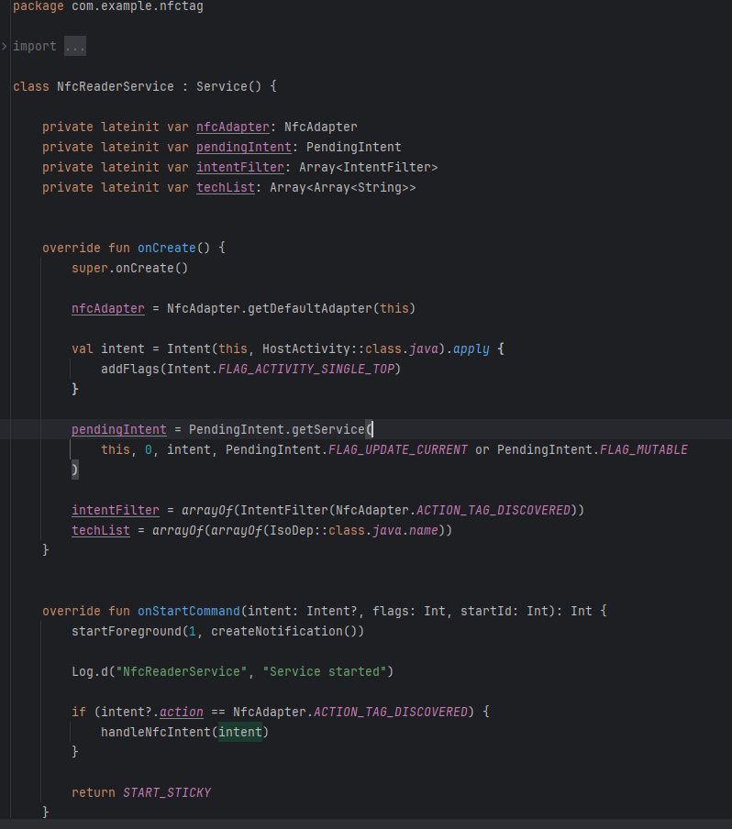
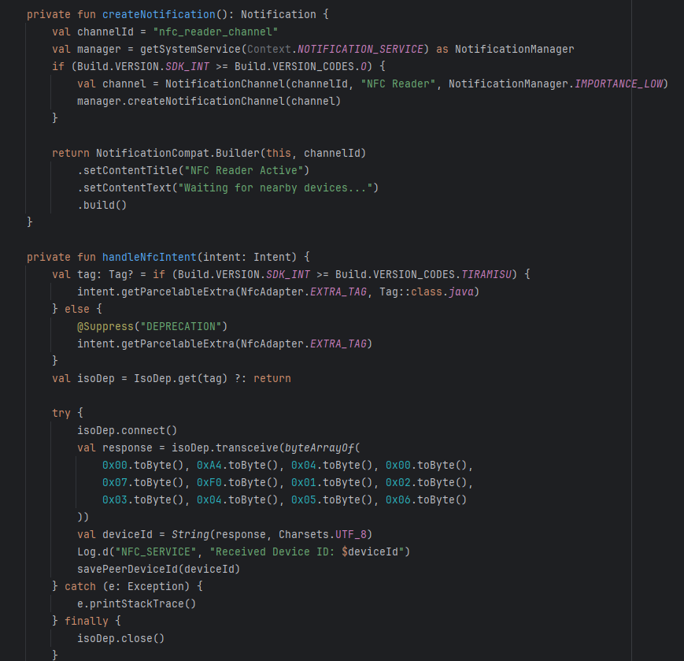
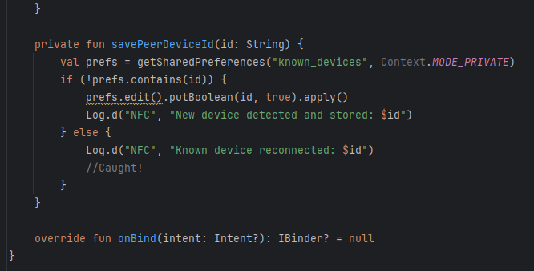
NFC Reading
The 'Hunter' device reads the HCE signal from the 'Host' device to register a 'Catch'. This is handled by the NfcReaderService. During setup this is also used by the 'Host' to register each playing device to the game. (MASSIVE WIP)

